Slide 1
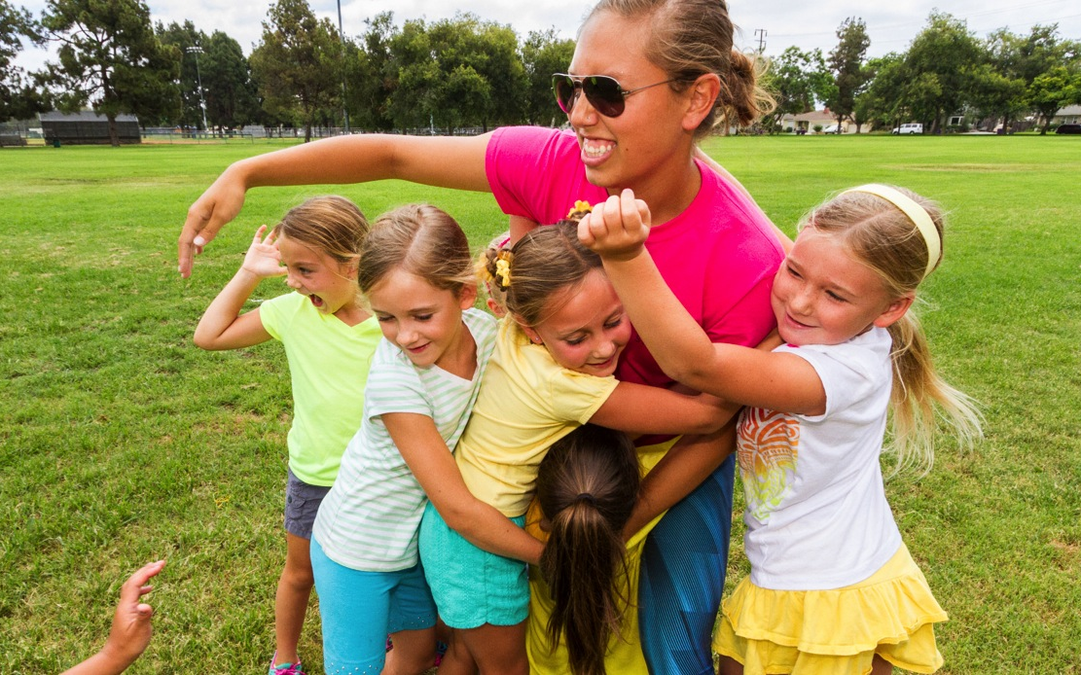

How to Talk About Girl Scouts

Slide 2
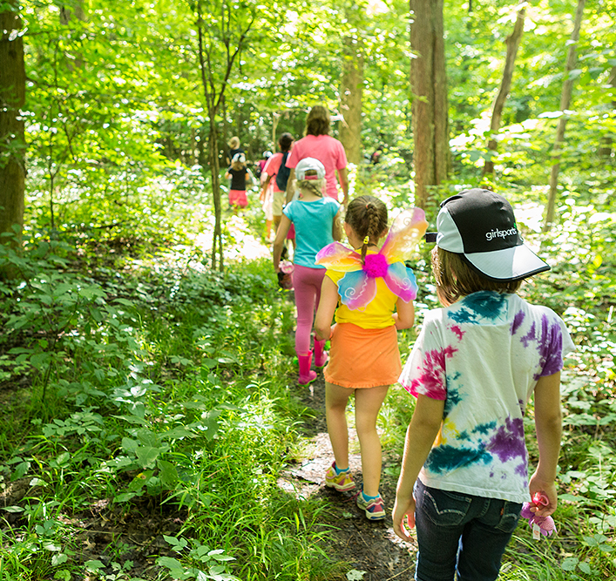
Types of Events
Recruitment
Back-to-School
  Meet the Teacher
  Stock the Locker
Community Events
SU Registration Nights

Slide 3
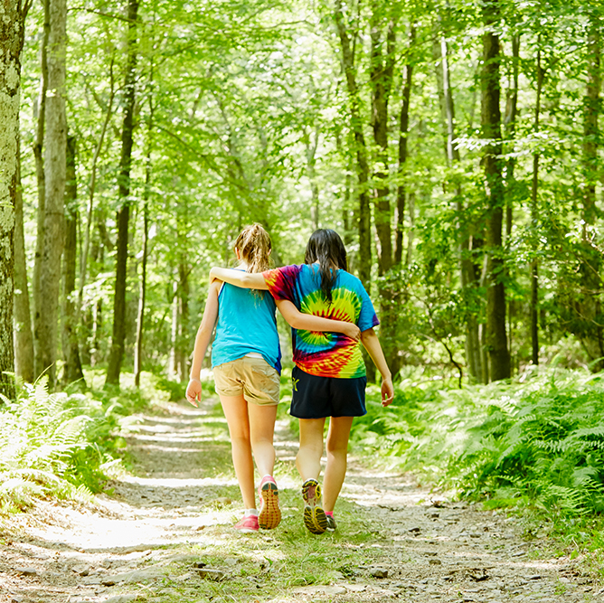
Staffing a Recruitment Event
Experience and peers from other councils express that,
TWO PEOPLE
at minimum, are needed for a successful recruitment event!

Slide 4
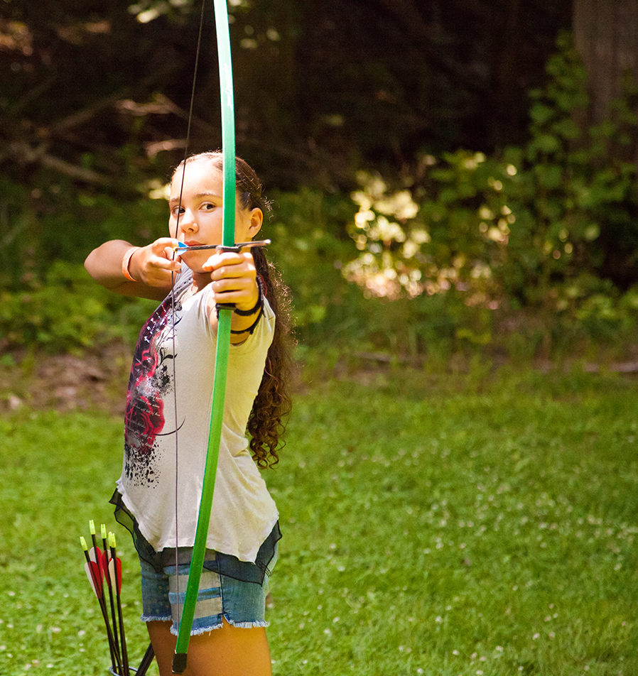
Recruiter Tool Kit
You may want to have:
  One-sheets on “why” GS’s
  Pencils or other giveaways
  Girl activity example
  Sample of Uniform piece
  Sign-in sheet
  Table display
  Table cloth
  Signage/Pop-up banner

Slide 5
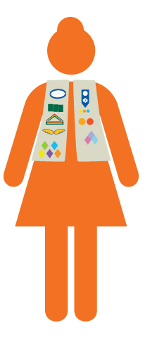
Additional Support
Greeter
Offering Directions
Set-up/tear-down
Girl craft/activity

Slide 6



Why Girls & Society need Girl Scouting
Girl Scouts are more likely than non-Girl Scouts to…
Government: Girl Scouts represent…
Take on leadership positions
Advocate for themselves and others
Embrace new experiences & overcome failure
Have strong female networks
Care about social injustice
Set ambitious goals and think about their future
Have higher levels of civic engagement
Have attained undergraduate education (38% vs 28%)
Have a higher household income ($51.7K vs. $42.2K)
58% of women in the 114th Congress
75% of current female senators
5 of the 6 female Governors
Every female Secretary of State in U.S. History
Business: Girl Scouts…
Represent more than half (52%) of women in business
Are more likely to have a business degree
Science: Girl Scouts…
Represent nearly all American female astronauts who have flown in Space

Slide 7
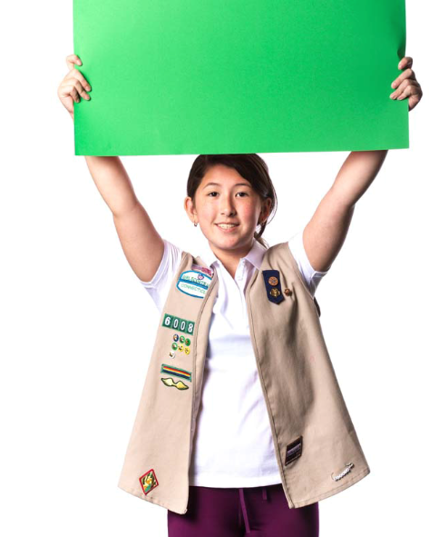
Girl Scouts are MORE LIKELY to:
The DNA of a Girl Scout
Set ambitious goals and think about the future
I’m a
Girl Scout!
Practice empathy & emotional intelligence
Be more financially literate and negotiate for themselves
Care about (and take action against) social injustices
Be more solution oriented and less likely to be a bystander
Advocate for herself and others
Self-identify as a leader and take on leadership roles
Embrace new experiences and overcome failure

Slide 8


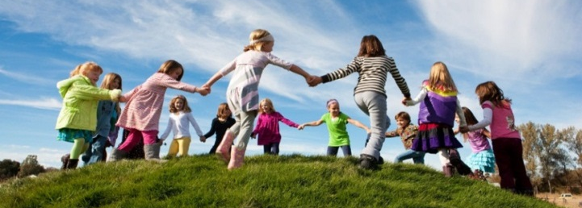
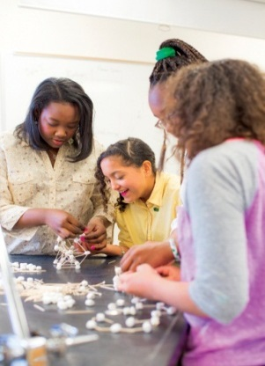
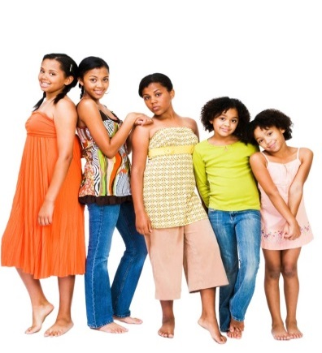
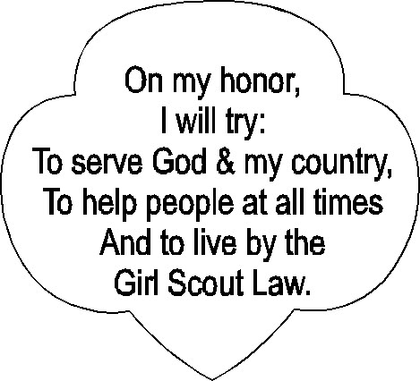
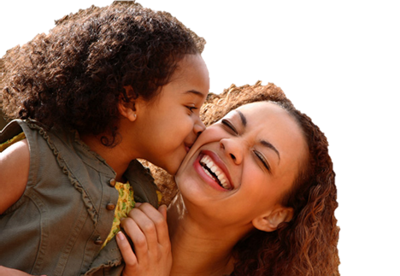
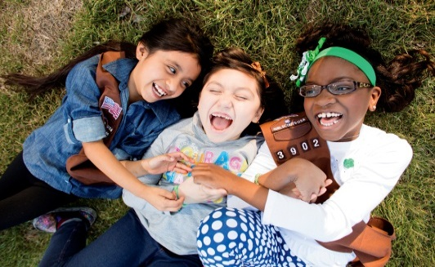
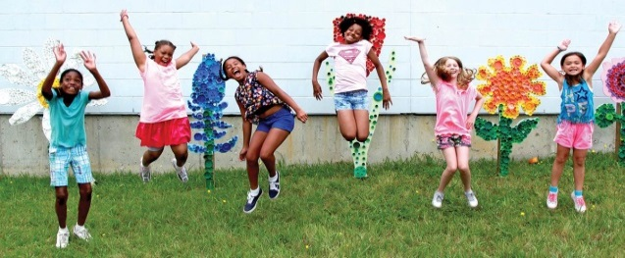
Core of the Girl Scout Experience
Inclusive Sisterhood
Fun & Play!
Girl Scout Leadership Experience
Supportive Adult
New
Experiences
Regular &
Progressive
Experiences
Promise & Law
8
Girl Only Safe Space
Outdoors

Slide 9
Frequently Asked Questions
How do members sign up for Girl Scouts? “Join Now” or “Volunteer Today” on our home page.
What if a parent asks me about the time commitment? Answer them with a question, “How much time do you have to give?”
How do I respond to a question I don’t have the answer to? Always know you can refer people to the council.
How can someone be involved without being a troop leader or having a daughter? Community Advocate! They can share info about GS in their community, with the support of our Recruitment team.
How am I supported as a volunteer? Other leaders in your community, new leader/age level training, and your council support team.

Slide 10
Fun Talking Points
Share your personal connection to Girl Scouts. Why is it a passion for you?
The Cookie and Fall Product Programs teach girls valuable skills and provide them a way to earn credits to participate in other fun activities.
Promote the great things happening at your school and in your neighborhood.
Point out all of the events Girl Scouts can do together – from camp to field trips with local organizations and more – all listed on our website!

Slide 11
Questions?
Ideas?

